Slide 1

JURISIGHT: INTERPRETABLE LEGAL DOCUMENT CLASSIFICATION AND VERDICT PREDICTION
USING TRANSFORMER-BASED NLP MODELS
PRESENTED BY: LITHILA GINIGE
SUPERVISOR: MR. SHAVIN FERNANDO
UNIVERSITY OF WESTMINSTER – SCHOOL OF COMPUTER SCIENCE AND ENGINEERING
DATE: NOVEMBER 12, 2025

Slide 2

AGENDA
Definition of the Problem
Aims, Objectives, and Scope
Background Review
Comparison with Existing Systems
Tools & Technologies
Use Cases & Diagrams
Requirements Elicitation
Time Schedule (Gantt Chart)
References

Slide 3
DEFINITION OF THE PROBLEM
PROBLEM DESCRIPTION
SIGNIFICANCE
Legal professionals and law students often struggle to analyse lengthy legal documents and predict verdict outcomes due to the complexity of legal language, lack of automated tools, and non-transparent AI systems. Existing verdict prediction models provide outputs without clear reasoning, limiting user trust and legal applicability.
This project aims to bridge the gap between legal reasoning and AI prediction by introducing explainability and interpretability into the verdict prediction process, supporting legal education, research, and AI-assisted
decision-making.

Slide 4
Understanding the Legal AI Problem Space
Growing volume of legal case data makes manual review inefficient.
Legal professionals face complexity and information overload.
Existing AI tools lack transparency and interpretability.
Legal domain demands systems that are both accurate and explainable.

Slide 5
AIM OF THE PROJECT
The primary goal of this project is to develop an interpretable AI system — Jurisight — that predicts verdicts from legal documents while explaining the rationale behind predictions using Explainable AI (XAI) techniques.

Slide 6
OBJECTIVES
Review transformer-based legal NLP models.
Design a framework for interpretable verdict prediction.
Implement document preprocessing and segmentation.
Integrate XAI tools for model transparency.
Develop Streamlit interface for visualization.
Evaluate interpretability and accuracy using ECHR/ILDC datasets.

Slide 7


PROJECT SCOPE
INCLUSIONS
EXCLUSIONS
Legal document classification and verdict prediction
Integration of Explainable AI visualizations
User-friendly interface for legal users
Real-time legal advice or automation
Multilingual or cross-jurisdictional predictions
Live legal database integration

Slide 8
Research Questions
How effectively can transformer-based models classify and predict verdicts from legal text?
Can XAI methods (SHAP, LIME, Attention) improve interpretability and user trust?
How can model reasoning be aligned with human legal interpretation?
What are the trade-offs between accuracy and transparency in legal NLP systems?

Slide 9


BACKGROUND REVIEW
KEY FINDINGS FROM LITERATURE
RESEARCH GAP
Transformer models like BERT, Legal-BERT, and CaseLaw-BERT outperform traditional ML.
Lack of interpretable verdict prediction systems that align AI reasoning with human legal logic.
Most research focuses on accuracy, not interpretability.
Long-document context loss is a major limitation.
Explainable AI (SHAP, attention) can enhance human trust and understanding.

Slide 10
EXISTING SYSTEMS (COMPARISON)
Existing System | Strengths | Weaknesses
Legal-BERT | Domain-specific understanding | Lacks transparency in predictions
CaseLaw-BERT | Good contextual learning | No interpretability layer
Judgment Prediction (CAIL2018) | Large dataset | Focused on Chinese law, limited explainability
DIFFERENTIATION (GAP ANALYSIS)
Jurisight combines verdict prediction + explainable reasoning + user interface. It bridges AI and legal logic using transparent visualization.

Slide 11
TOOLS & TECHNOLOGIES
SOFTWARE
HARDWARE
Tool | Purpose / Justification
Python | Development (Robust NLP libraries)
HuggingFace Transformers | Model fine-tuning (Pre-trained legal models)
PyTorch | Deep learning framework (Model training)
Streamlit | Web app interface (Easy model deployment)
SHAP / LIME | Explainable AI (Transparency and trust)
Excel / ClickUp | Project timeline tracking
Standard laptop/PC with GPU
Google Colab

Slide 12
USE CASES
Upload Legal Document → Predict Verdict
View Explanation → Visualize Key Sections
Admin → Manage dataset/model
ACTORS
Law Student / Legal Professional
System Administrator
AI Model

Slide 13
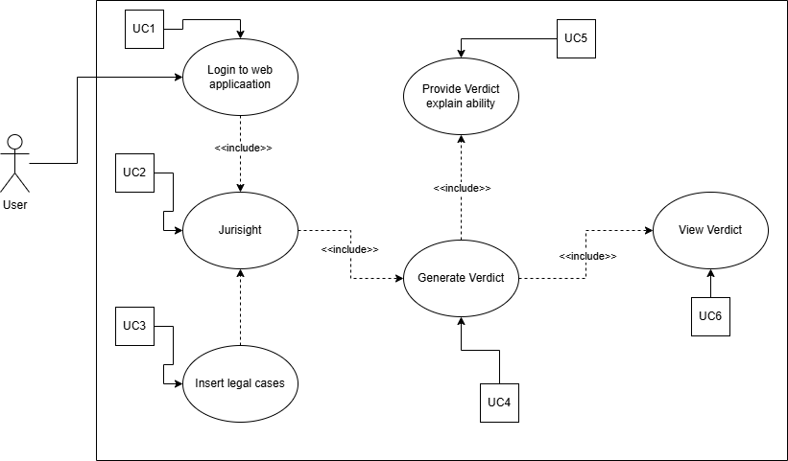
USE CASE DIAGRAM

Slide 14
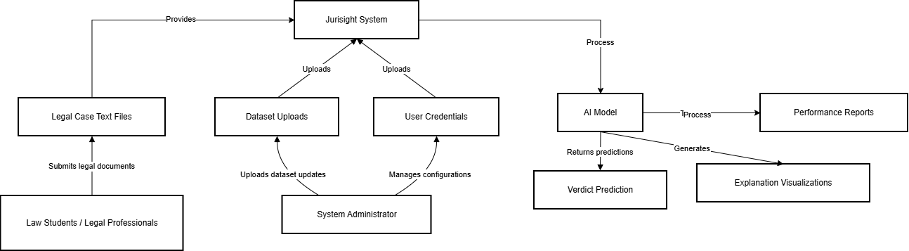
CONTEXT DIAGRAM

Slide 15
REQUIREMENTS ELICITATION
APPROACH
TECHNIQUES
Interviews with legal professionals & law students
Document analysis of existing systems
Use case analysis
Brainstorming
Requirement prioritization

Slide 16
FUNCTIONAL REQUIREMENTS
FR01 - The system must allow users to upload legal case documents for analysis.
FR02 - The system must classify legal documents and predict verdicts using Transformer-based models.
FR03 - The system must generate explanations for model predictions using SHAP, LIME, and Captum.
FR04 - The system should provide a web interface to display verdicts and explanations interactively.
FR05 - The administrator should be able to retrain or update the model with new datasets.
FR06 - The system could allow users to export verdict reports in PDF format.
FR07 - The system could store user interaction logs for future research.

Slide 17
NON-FUNCTIONAL REQUIREMENTS
NFR01 - Accuracy - The system must achieve ≥80% accuracy on ECHR test data.
NFR02 - Explainability Quality - Explanations must be faithful (aligned with influential tokens) and understandable to users.
NFR03 - Performance - Average inference time per document must be <5 seconds on GPU.
NFR04 - Fairness - The model should minimize bias across case types and entities.
NFR05 - Security - Uploaded documents must be encrypted and not stored permanently.
NFR06 - Usability - The interface should be intuitive for non-technical users.

Slide 18
Expected Outcomes
Achieve ≥80% F1-score for verdict prediction.
Generate faithful and human-aligned explanations.
Deliver an intuitive and usable interface for law students.
Enhance trust in AI-assisted legal analysis and education.

Slide 19
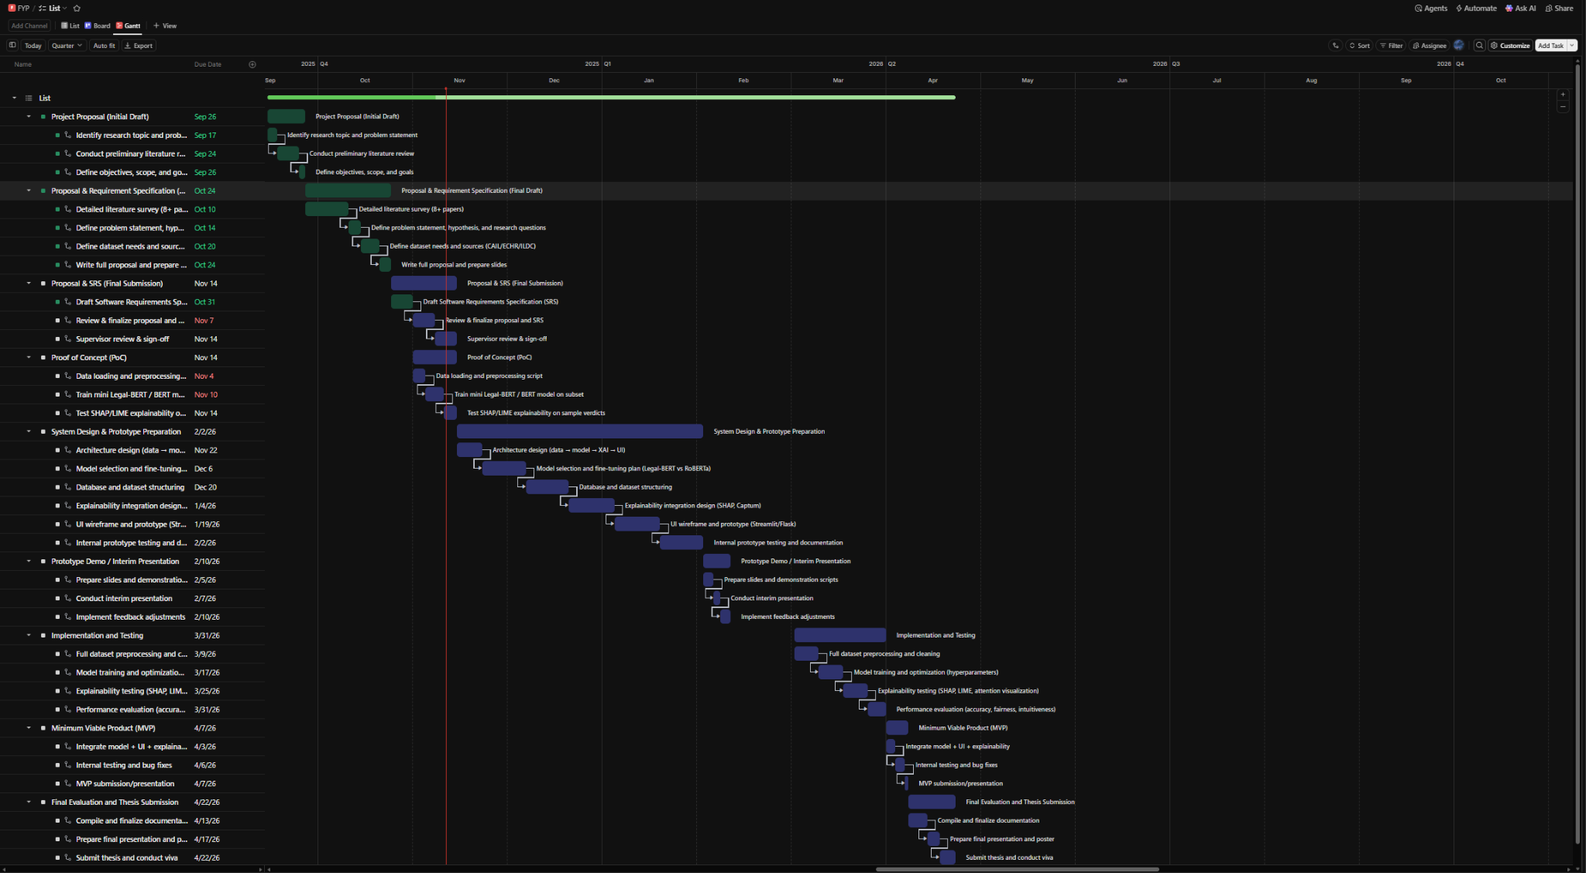
GANTT CHART OVERVIEW

Slide 20
FUTURE IMPLEMENTATION PLAN
Fine-tune Legal-BERT/RoBERTa models
Integrate SHAP/Captum explanations
Conduct human-aligned evaluation
Deploy Jurisight web interface

Slide 21
Ethical and Legal Considerations
Only anonymized and publicly available datasets will be used.
Model evaluated for fairness across case types.
Explanations ensure transparency and accountability.
Jurisight supports decision-making, not legal advice.
Complies with responsible AI and GDPR data guidelines.

Slide 22
REFERENCES
Chalkidis, I. et al. (2022). “LexGLUE: A Benchmark Dataset for Legal Language Understanding.” ACL 2022.
Turan, F. & Küçüksille, E. (2025) Interpretable Transformer Models for Legal Text Classification. Expert Systems with Applications.
Zhong, H. et al. (2020). “How Does NLP Benefit Legal System.” COLING 2020.
Ramani, M. & Venugopalan, S. (2025) Explainable Transformer Architectures for Legal Verdict Prediction. Journal of Intelligent & Fuzzy Systems.
Wang, P. et al. (2023). “Explainable Verdict Prediction.” Information Processing & Management, 60(2).
Gong, Z., Lin, B. & Zhang, J. (2024) Explainable Legal Judgment Prediction via Multi-View Attention Networks. IEEE Transactions on AI.

Slide 23
THANK YOU
Questions?

